Slide 1
Week 8
smart table design

Slide 2
Course Plan
Smart table design
Watch a video

Slide 3
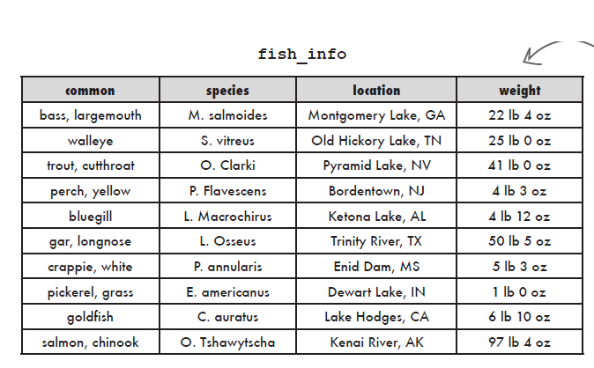

Two different table design
Mark table
Jack and Mark both created tables to store information about record‑setting fish.
Write a query for each table to find all records from New Jersey.
Now, its time to take a look at Jack table…

Slide 4
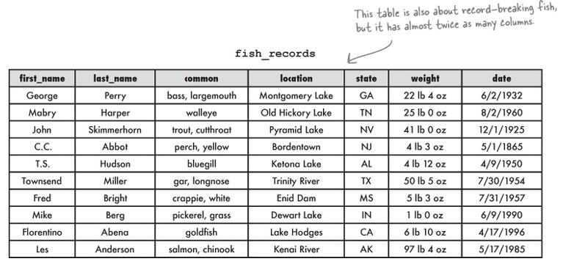
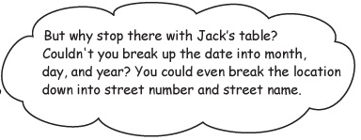


Two different table design (Con.)
Jack table
Which one is better?
Write a query for each table to find all records from New Jersey.

Slide 5
Relationship
A table is all about relationships
Pick your thing, the one thing you want your table to describe.
Make a list of the information you need to know about your one thing when you’re using the table.
Using the list, break down the information about your thing into pieces you can use for organizing your table.

Slide 6

Atomic data
A little piece of information that can’t or shouldn’t be divided.
A good example:
Consider a pizza delivery guy. To get to where he’s going, he just needs a street number and address in a single column. For his purposes, that’s atomic. He never needs to look for a single street number on its own.
In fact, if his data were broken into street number and street name, his queries would have to be longer and more complicated, making it take him longer to get the pizza to your front door.

Slide 7
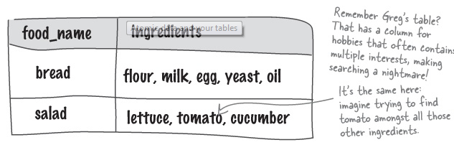
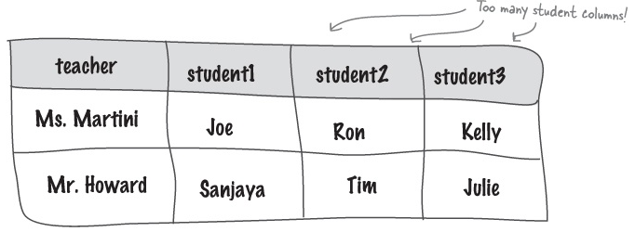
Atomic Rules:
RULE 1: A column with atomic data can’t have several values of the same type of data in that column.
RULE 2: A table with atomic data can’t have multiple columns with the same type of data.

Slide 8
Reasons to be normal
Making your tables NORMAL means they follow some standard rules your new designers will understand.
First Rule: Use Atomic Data

Slide 9
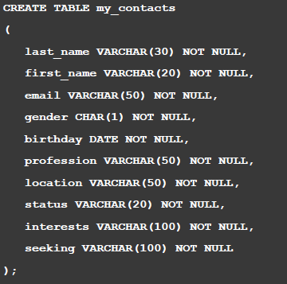
Discussion:
Which columns are violating the rule?

Slide 10
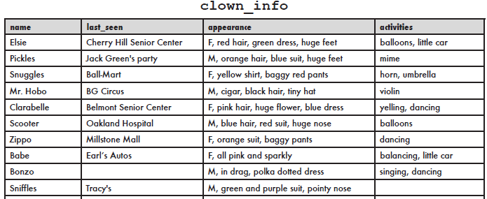
Discussion:
Which column(s) are violating the rule?

Slide 11
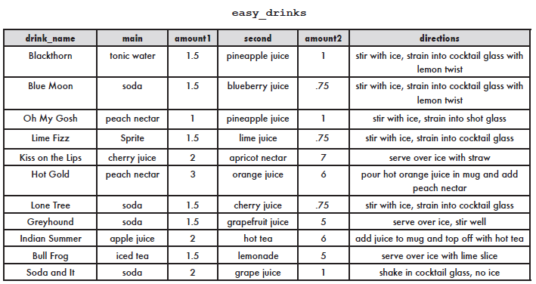
Discussion:
Which column(s) are violating the rule?

Slide 12
The benefits of normal tables
Normal tables won’t have duplicate data, which will reduce the size of your database.
With less data to search through, your queries will be faster.

Slide 13
FIRST NORMAL FORM or 1NF.
Each row of data must contain atomic values.
Each row of data must have a unique identifier, known as a Primary Key.
A primary key is a column in your table that makes each record unique.

Slide 14
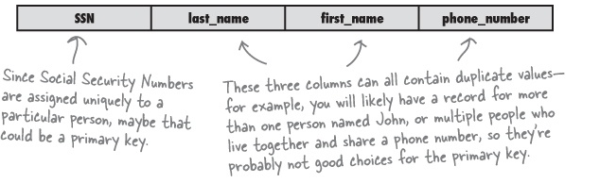
PRIMARY KEY rules
Example:
The primary key is used to uniquely identify each record
A primary key can’t be NULL
The primary key must be given a value when the record is inserted
A primary key should contain only the information it needs to be unique and nothing extra.
The primary key values can’t be changed
The best primary key may be a new primary key.

Slide 15
Assignment & questions
Watch The video using your headphone and then start the assignment if you have extra time.

Slide 16
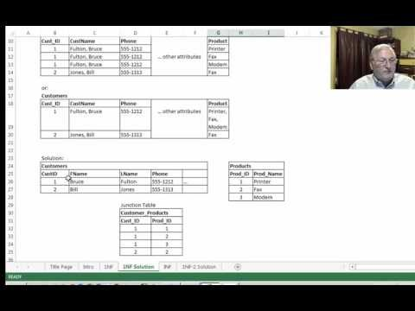
First Normal Form

